Slide 1

(5)
File System vs DBMS
Infoway Technologies, 3rd Floor Commerce Centre, Rambaug Colony, Paud Road Pune 411038

Slide 2
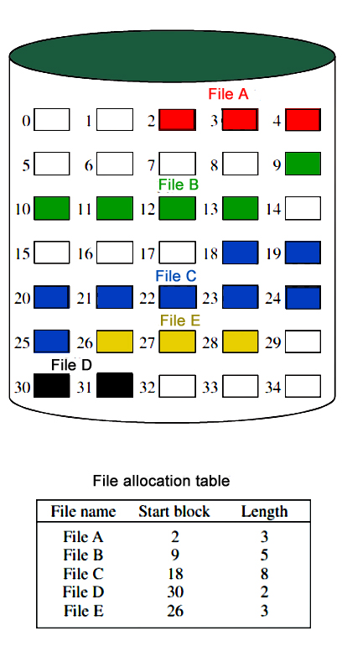
File System
(5)
A filesystem is the methods and data structures that an operating system uses to keep track of files on a disk or partition; that is, the way the files are organized on the disk.
A flat file database is a database that stores data in a plain text file. Each line of the text file holds one record, with fields separated by delimiters, such as commas or tabs. While it uses a simple structure, a flat file database cannot contain multiple tables like a relational database can
Infoway Technologies, 3rd Floor Commerce Centre, Rambaug Colony, Paud Road Pune 411038

Slide 3
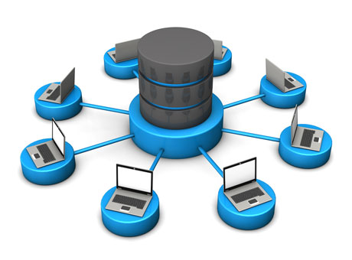

DBMS
(5)
database: Is the collection of related data which is organized, which is also called as structured data.
management system: is a software package designed to manipulate, retrieve and manage data in a database.
Infoway Technologies, 3rd Floor Commerce Centre, Rambaug Colony, Paud Road Pune 411038

Slide 4
Advantages and Disadvantages of Flat Files
(5)
The biggest advantage of file-based storage is that anyone can understand the system.
Advantages | Disadvantages
Low price | Slow access times
Easy to use
Easily scalable
Infoway Technologies, 3rd Floor Commerce Centre, Rambaug Colony, Paud Road Pune 411038

Slide 5



Advantages and Disadvantages of DBMS
(5)
Advantages | Disadvantages
Improved data sharing | Increased costs
Improved data security | Complexity
Minimized data inconsistency | Performance
Improved data access | Frequency Upgrade/Replacement Cycles
client/server Technology
Highly Secured
Relationship (PK/FK)
Infoway Technologies, 3rd Floor Commerce Centre, Rambaug Colony, Paud Road Pune 411038

Slide 6
File System vs DBMS
(5)
File Management System | Database Management System
File System is a general, easy-to-use system to store general files which require less security and constraints. | Database management system is used when security constraints are high.
Data Redundancy is more in file management system. | Data Redundancy is less in database management system.
Data Inconsistency is more in file system. | Data Inconsistency is less in database management system.
Centralization is hard to get when it comes to File Management System. | Centralization is achieved in Database Management System.
User locates the physical address of the files to access data in File Management System. | In Database Management System, user is unaware of physical address where data is stored.
Security is low in File Management System. | Security is high in Database Management System.
File Management System stores unstructured data. | Database Management System stores structured data.

